Slide 1
Urban Greenspace Location Optimization
Proposal for Toronto Parks and Recreation
Created by:
Christian Geofroy, Gloria Lim, Jong Su Kim, Muhamad Muizzuddin & Zinran Jeffrey Zhou
(Group 12)
StoryMap Link: https://storymaps.arcgis.com/stories/ef0c1c29c1444b34ab4ade01f3666ce0

Slide 2
Background
Urban Greenspaces (UGS) is important for the sustainable development of a city. UGS in this project is defined as Toronto public parks.
There are various ecosystem services provided by UGS that bring benefits to the community.
According to Russo & Cirella (2018), a city in Slovenia called Ljubljana, was awarded the 2016 European Green Capita was reported to have 560 m2 of UGS is available per inhabitant.
Most of its residential zones are within a 300 m radius from UGS (Russo & Cirella, 2018).

Slide 3
Problem Statement
We are submitting a proposal for the development for more urban greenspaces (UGS) to accommodate Toronto's growing population to the Toronto Parks and Recreation.
Study area: Toronto
In this project, we are recommending optimal locations for more UGS development based on the spatial analysis of existing Toronto parks distribution.
Data: Sources:
Toronto ward boundaries shapefile
Toronto public parks shapefile
Toronto sidewalk network shapefile
Toronto Open Data
Statistics Canada
ArcGIS Online

Slide 4
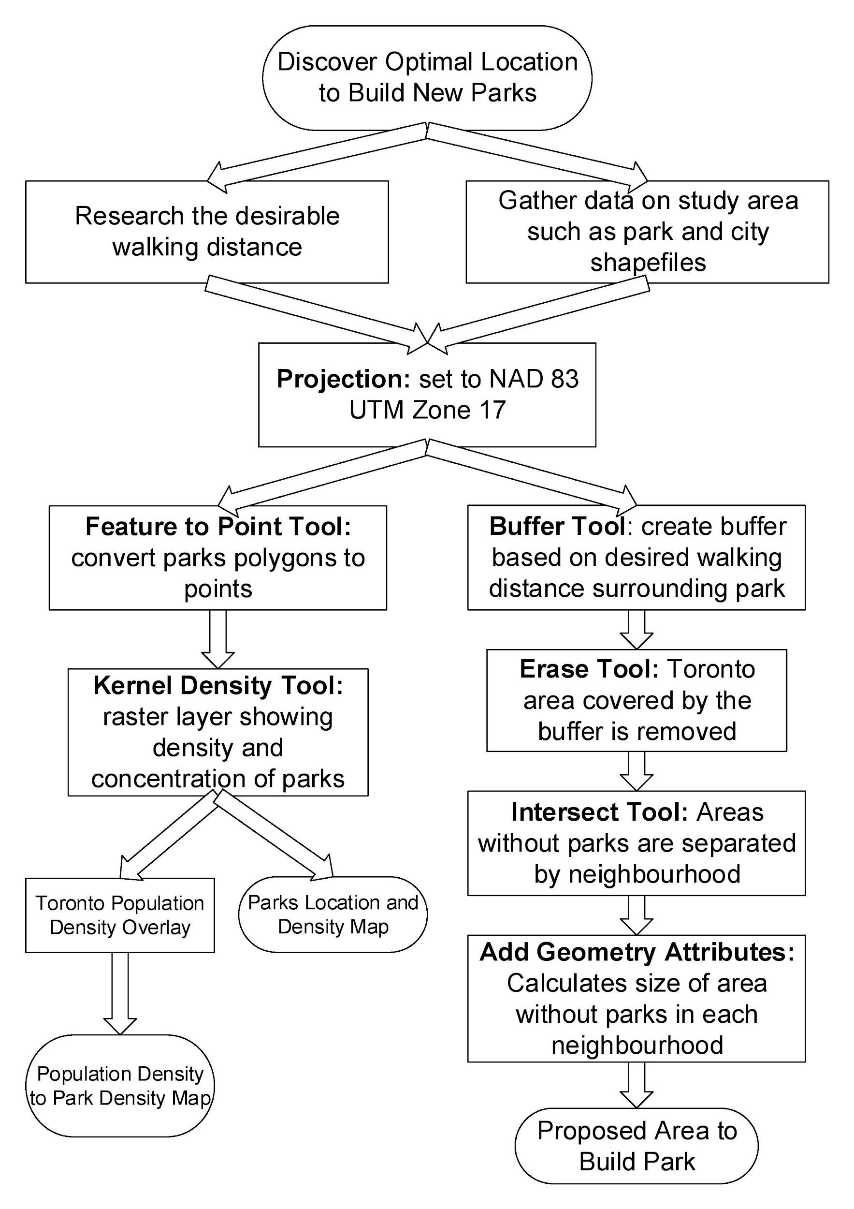
Flowchart
Tools used:
Project Tool
Feature to Point Tool
Kernel Density Tool
Buffer Tool
Erase Tool
Intersect Tool
Add Geometry Attributes Tool

Slide 5
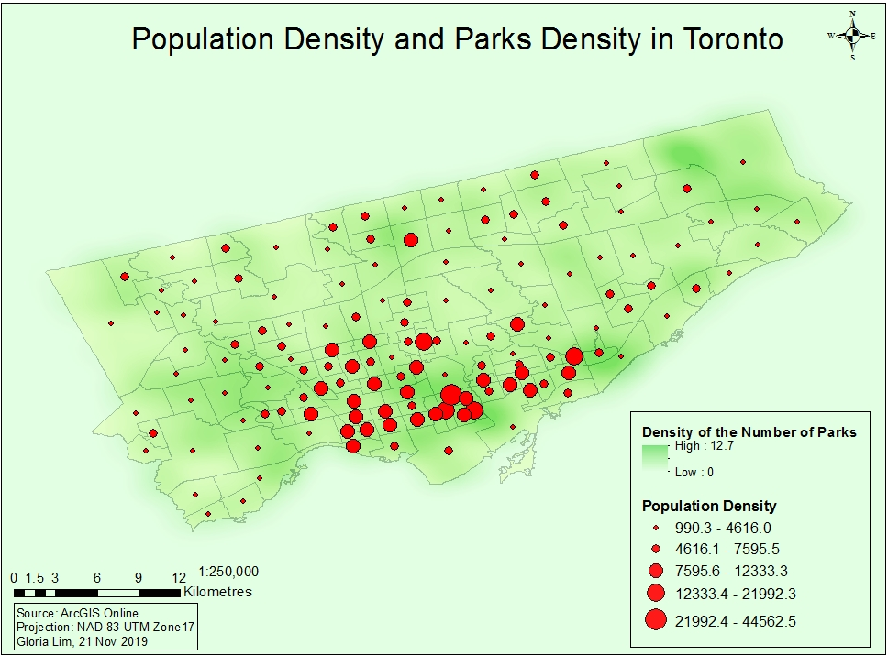
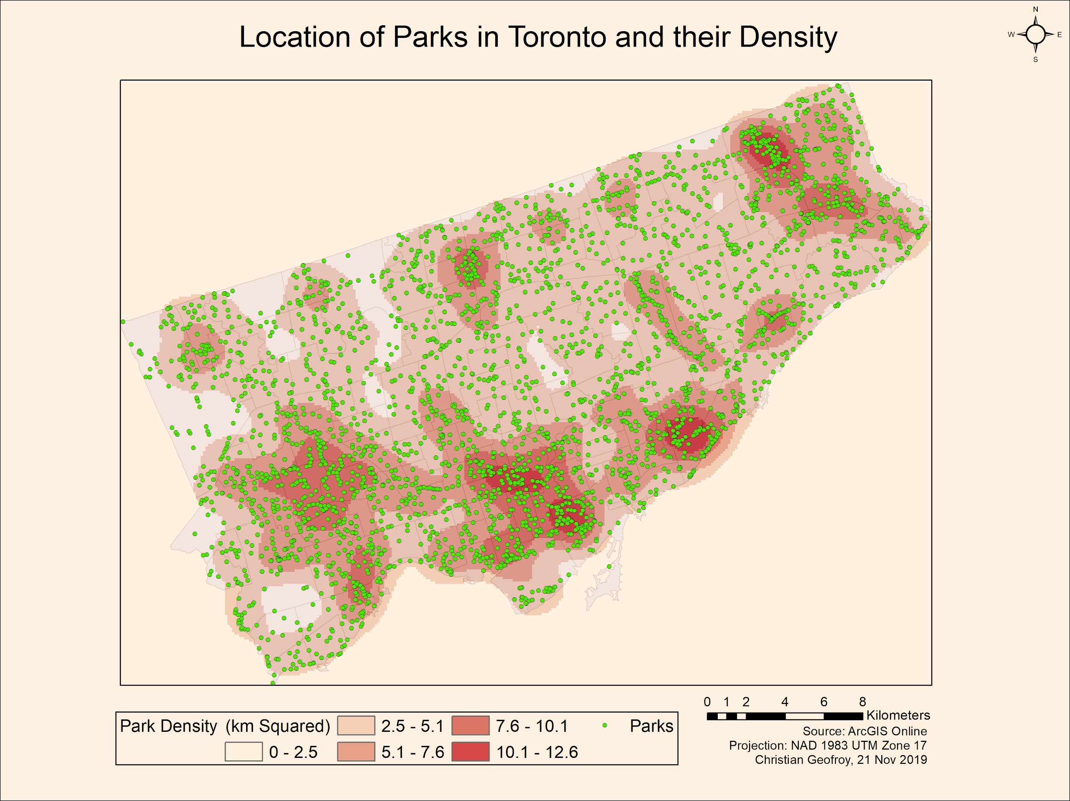
Geoprocessing
In the process of finding the locations of areas with low park density this map of the kernel density of the current parks in Toronto was created.
This map only takes into account the number of parks and not the size.
There are clusters of parks in the downtown area, Rexdale/Weston area, North York area, Scarborough Bluffs area and the Rouge National Urban Park area.

Slide 6
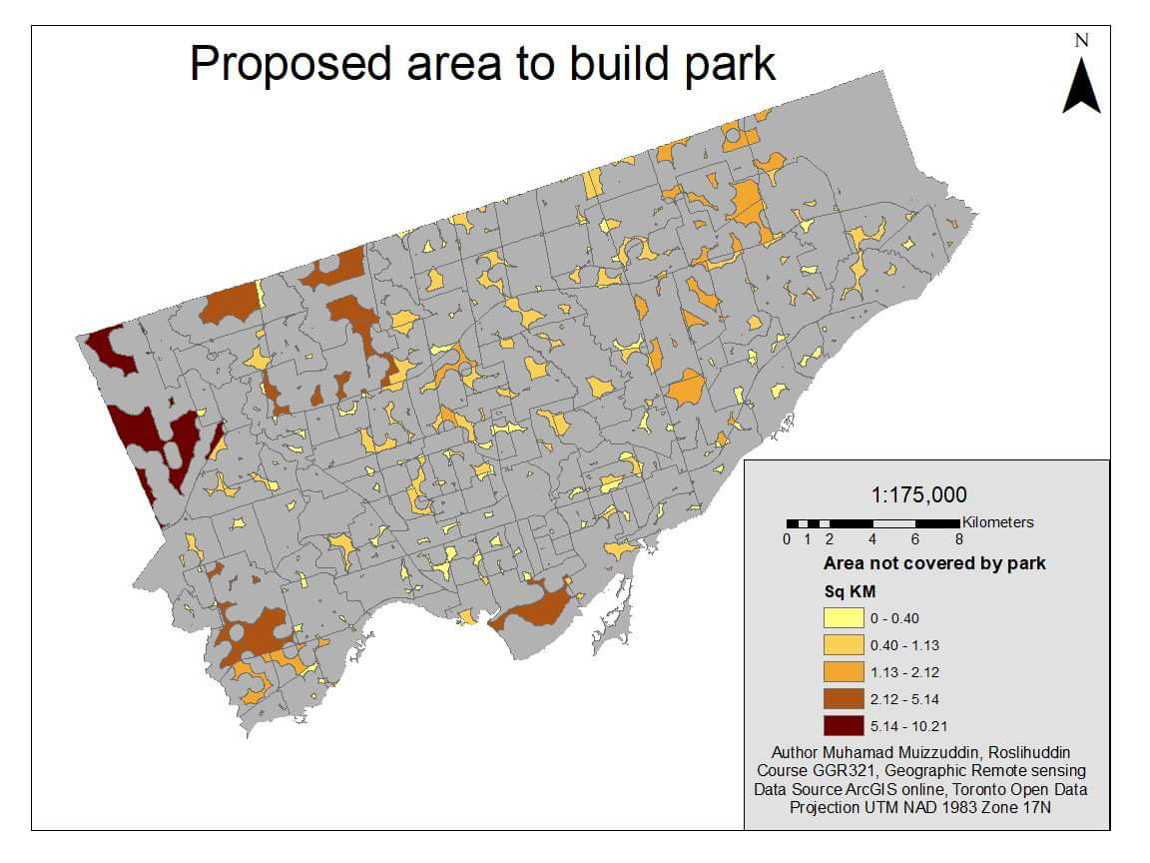
Results and Analysis
This map describe the area that are not covered by the park based on the 300m buffer.
Require park area ranges from 10 m2 to 10.21 km2.
For areas range from 0 - 0.40 km2, we suggest park expansion instead of creating a new park.

Slide 7
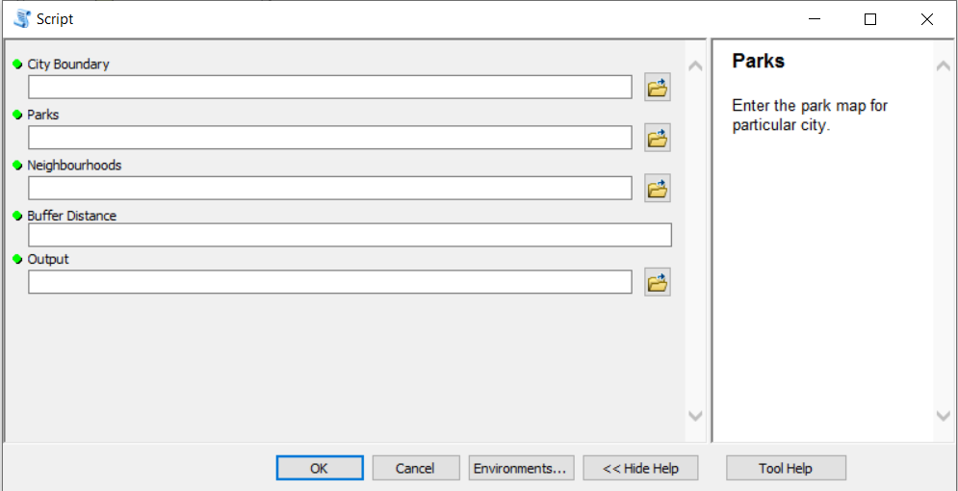
Script Tool
Tool can accept parameters
It has the ability to reproduce the steps previously with different parameters.
Such as:
New buffer distance
Different city
Updated Files
Notes:
test

Slide 8
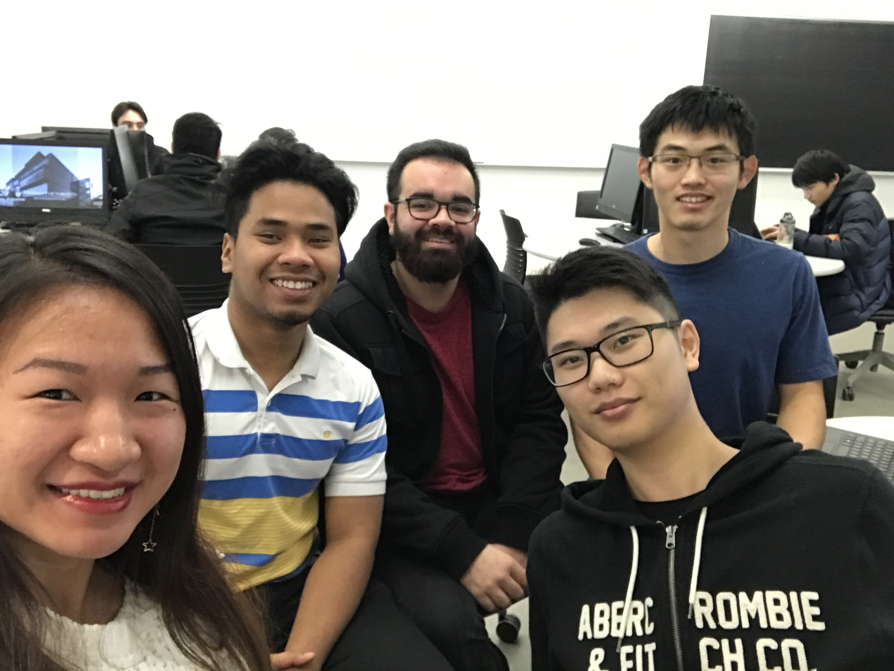
Member Contributions
Christian Geofroy: Created the Park Density map, helped with the presentation and brainstorming the idea
Gloria Lim: Suggested the use of StoryMap, brainstorming, created the population and UGS density map
Jong Su Kim: Developed the Python code for the script.
Muhamad Muizzuddin Roslihuddin: Create map of areas that require parks
Ziran Jeffery Zhou: Topic brainstorming, research, methods and flowchart

